Slide 1
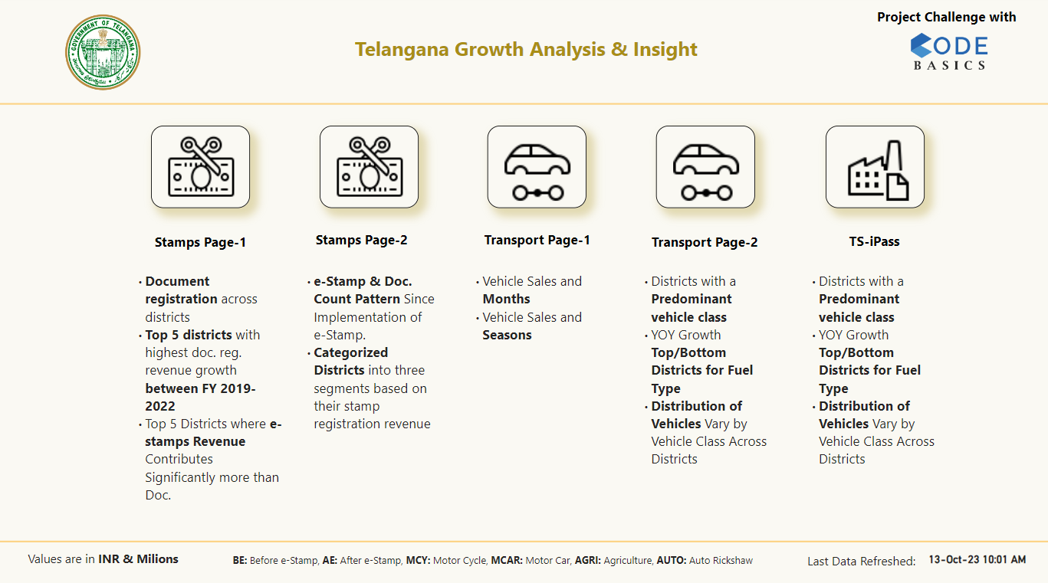

Slide 2
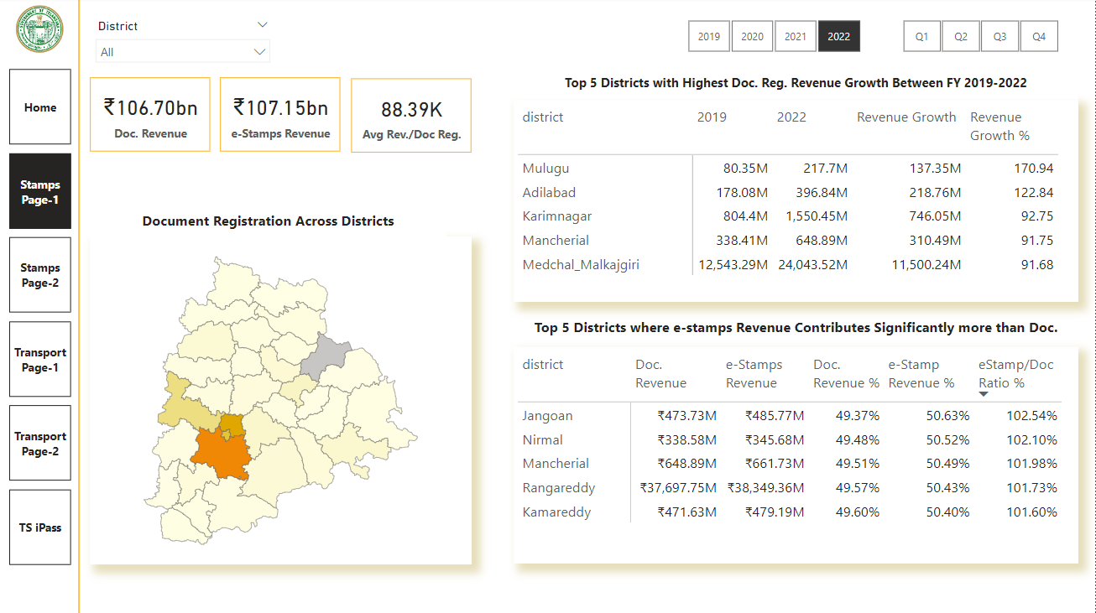
Average Document Revenue per Document Registration
Document Registration Vary Across Districts
The top 5 districts with the highest document registration revenue growth between FY 2019 and 2022:
Mulugu
Adilabad
Karimnagar
Mancherial
Medchal_Malkajgiri.
FY 2022
Jangoan, Nirmal, Mancherial, Rangareddy, and Kamareddy districts have substantial revenue from both Document and e-Stamps.
Rangareddy district leads in total revenue for both categories.
Districts maintain a balanced revenue distribution, with e-Stamps slightly higher than Document Revenue.

Slide 3
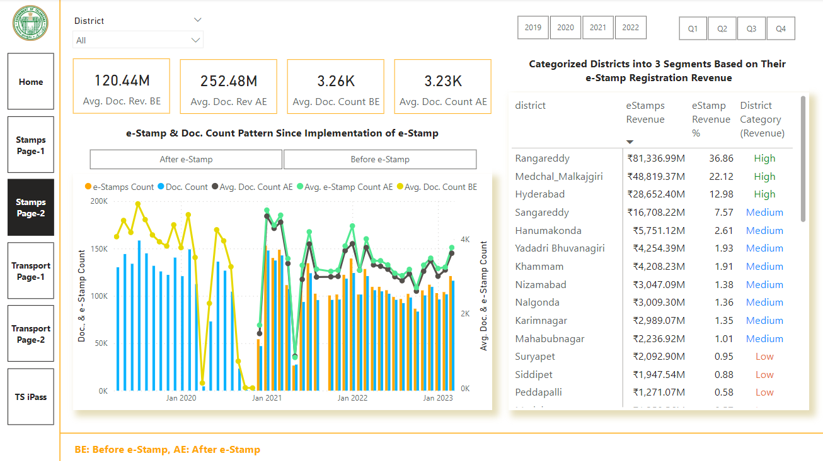
Average Document Revenue and Count Before & After e-Stamp implementation
Districts Categorized by e-Stamp Registration Revenue:
Revenue Segmentation: The districts are categorized into three segments based on their e-Stamp registration revenue: High (e-Stamp Rev>10), Medium(e-Stamp Rev>1 and <=10), and Low (e-Stamp Rev<=1).
It’s evident that the top three districts (Rangareddy, Medchal_Malkajgiri, and Hyderabad) generate a significant share of the e-Stamp registration revenue(“High”). In contrast, majority of districts fall into the "Low" category and contribute relatively smaller portions of revenue.
Effect on Growth: High-revenue districts are likely to have more resources and funding for infrastructure development, public services, and economic growth. Conversely, low-revenue districts may face challenges in funding essential projects and services.
Regional Disparities: These regional disparities can impact the growth and development of districts, as high-revenue districts have more resources and funding available for various developmental projects and services, potentially leading to better infrastructure, education, healthcare, and overall economic growth. Addressing these disparities may involve policies and initiatives aimed at redistributing resources and fostering growth in low-revenue districts to ensure more balanced regional development.
e-Stamp & Doc. Count Pattern Since Implementation of e-Stamp
The data shows a significant increase in both e-Stamp and document counts after the implementation of e-Stamp challan.
After implementation, there's a clear upward trend in e-Stamp and document counts from December 2020 to March 2023.
Clear increase in e-Stamp and document counts after the implementation of e-Stamp, which suggests improved adoption of the system.
Continued monitoring and improvement of the system, along with training and support, can further enhance its success.

Slide 4
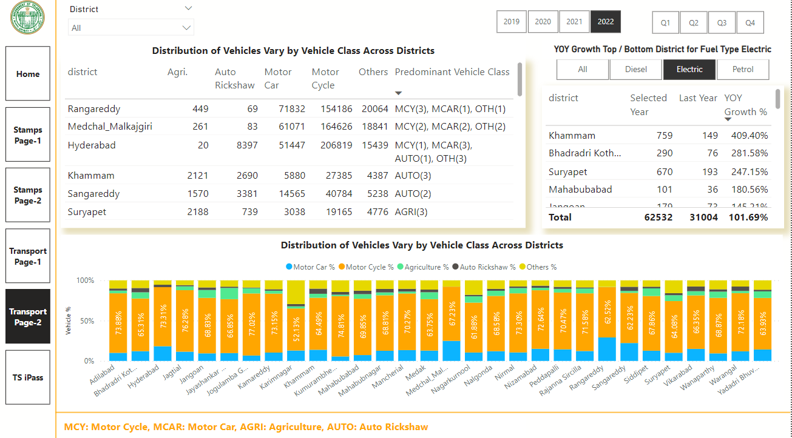


Distribution of Vehicles Vary by Vehicle Class Across Districts FY 2022
Motor cycle Dominance: Motorcycles are the most popular vehicle class in almost all districts, with percentages ranging from 52.13% to 77.02%. This suggests that motorcycles are the preferred mode of transportation in the region.
Motor Car Distribution: The distribution of motor cars varies widely across districts, with Hyderabad and Rangareddy having the highest percentages at 18.24% and 29.13%, respectively. This indicates higher urbanization and economic activity in these areas.
Agricultural Vehicles: The percentage of agriculture vehicles is relatively low in most districts, with the highest in Jayashankar Bhupalpally at 13.97%. This implies that non-urban areas have a more significant presence of agricultural vehicles.
Auto Rickshaws: Auto rickshaws are more prevalent in urban areas like Hyderabad and Medchal_Malkajgiri, where their percentages are relatively higher. This suggests their use as a mode of urban transport.
Top 3 Districts with Highest YOY Growth for Electric Vehicles:
Khammam (409.40%), Bhadradri Kothagudem (281.58%), Suryapet (247.15%) district has shown the highest YOY growth in electric vehicle sales, indicating a significant increase in the adoption of EVs.
The government should focus on understanding the factors that have contributed to this growth and consider replicating successful strategies in other districts.
The government should invest in charging infrastructure and awareness programs to sustain this growth.
Bottom 3 Districts with Highest YOY Growth for Electric Vehicles:
Wanaparthy (5.48%), Mahabubnagar (19.44%), Adilabad (20.22%) district exhibits low YOY growth, indicating room for improvement.
Overall, the government should continue to invest in charging infrastructure, provide incentives, and run awareness campaigns across all districts, with a special focus on replicating the success of districts with high growth rates to accelerate the adoption of electric vehicles throughout the region.
Distribution of Vehicles by District and Vehicle Class FY 2022:
Hyderabad, Medchal_Malkajgiri, and Rangareddy have a high number of motor cars and motorcycles, indicating urbanization and motorization. Encourage motor vehicle-related businesses, emission control, and mass transit.
Nalgonda, Siddipet, and Suryapet rely on agricultural vehicles.
Hyderabad has a diverse mix of vehicle classes.
Hyderabad, Sangareddy, and Khammam have potential for eco-friendly auto rickshaws.

Slide 5
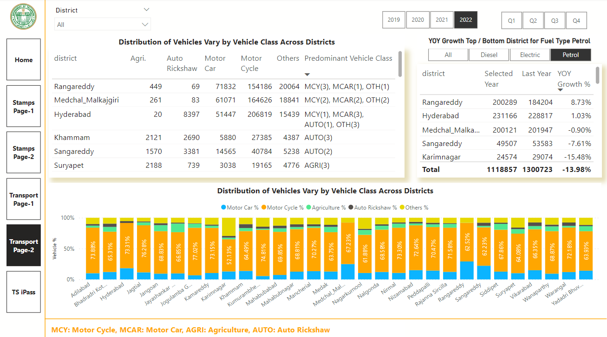

Districts with Highest YOY Growth for Petrol Vehicles:
While some districts experienced positive YOY growth in petrol vehicle sales, the majority of districts saw a decline in sales compared to the previous year.
Rangareddy had the highest YOY growth at 8.73%., however looking FY 2020, it shows decline.
Bottom 3 Districts with Highest YOY Growth for Petrol Vehicles:
Districts, such as Warangal, Nirmal, Jagtial, and Rajanna Sircilla, experienced significant negative growth, suggesting potential issues in the local automotive market or may be due to increase in electric vehicles growth.

Slide 6
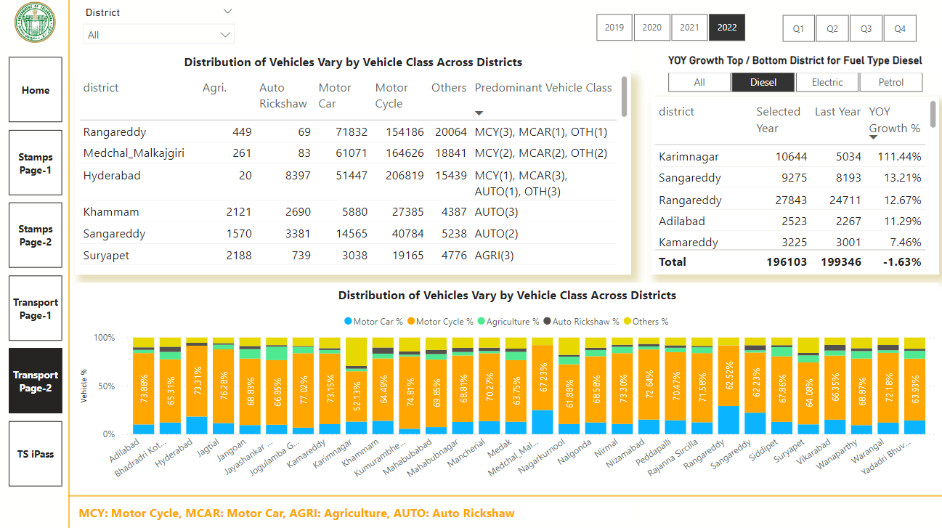

Top 3 Districts with Highest YOY Growth for Diesel Vehicles:
Karimnagar, Sangareddy and Rangareddy shows the highest growth in diesel vehicle sales.
Bottom 3 Districts with Highest YOY Growth for Diesel Vehicles:
Districts, such as Warangal, Mahabubabad,and Jagtial experienced significant negative growth,
Given the overall negative YOY growth in many districts, the government might want to promote alternative and environment-friendly modes of transportation, such as electric or hybrid vehicles. Encouraging a shift toward cleaner vehicles can have a positive impact on the environment and public health.

Slide 7
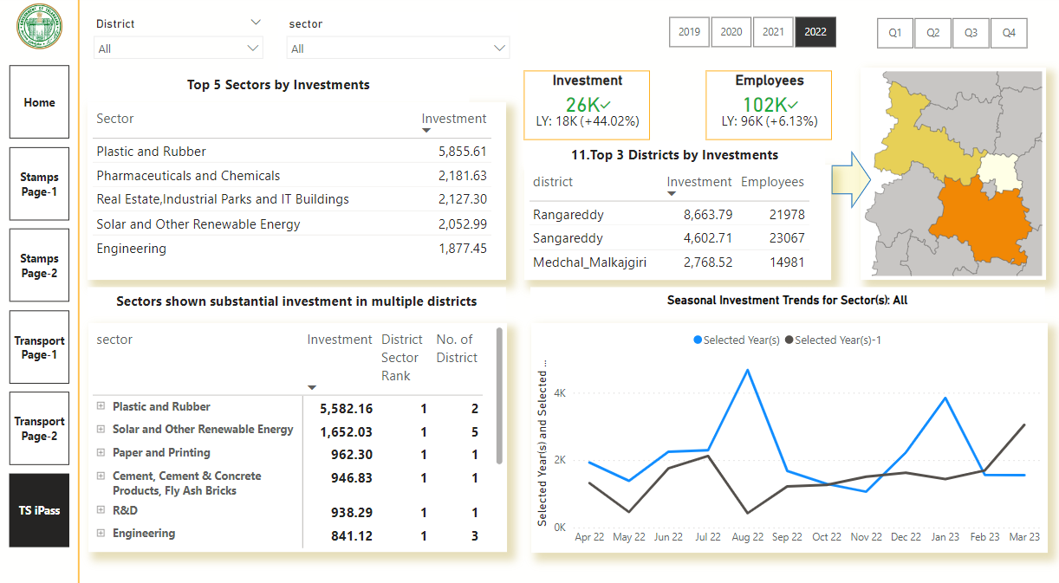
Top 5 sectors that have witnessed the most significant investments in FY 2022.

Slide 8
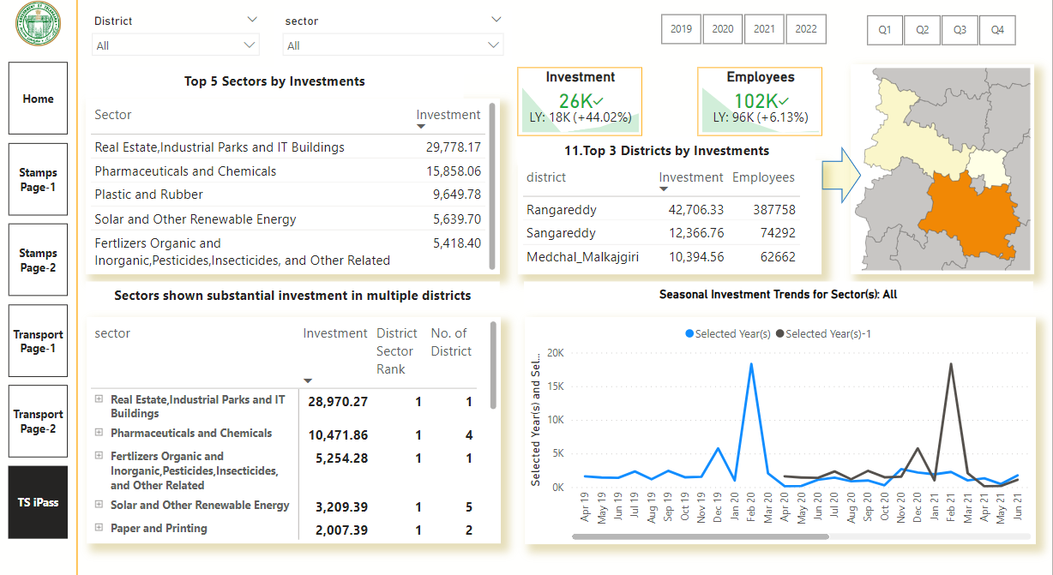
The Top 3 Districts that have Attracted the Most Significant Sector Investments During FY 2019 to 2022

Slide 9
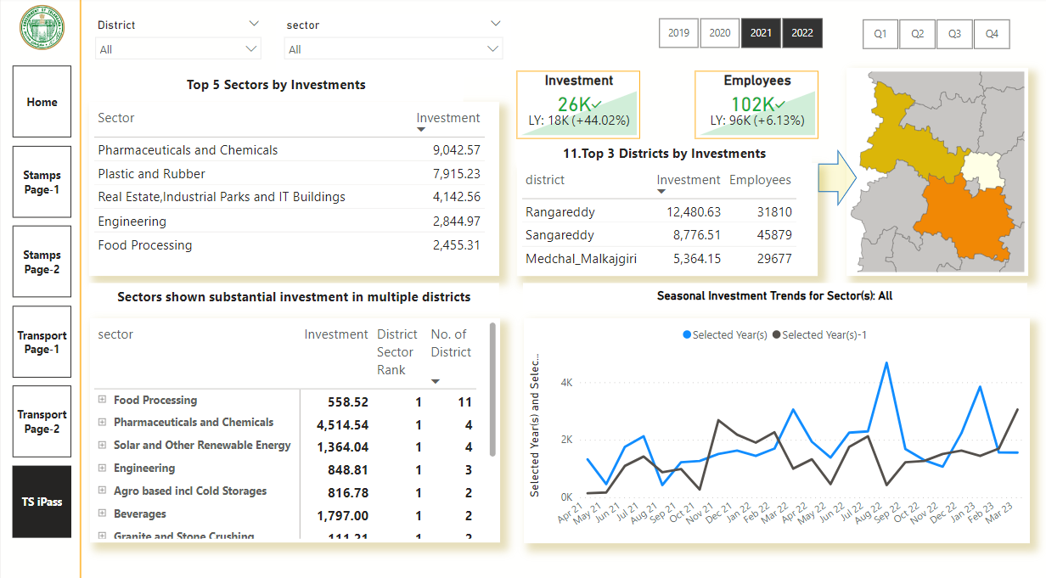
Select the sector and check below bottom right chart “Seasonal Investment Trends for Sectors” to analyze for the particular sector. Also change the top FY filter to see trend for years, sector and seasons.
Sectors that have Shown Substantial Investment in Multiple Districts Between FY 2021 and 2022

Slide 10


Stamp Registration: Insight Summary
The top 5 districts with the highest document registration revenue growth between FY 2019 and 2022: Mulugu 2. Adilabad 3.Karimnagar 4. Mancherial 5. Medchal Malkajgiri.
FY 2022: Jangoan, Nirmal, Mancherial, Rangareddy, and Kamareddy districts have substantial revenue from both Document and e-Stamps.
  Rangareddy district leads in total revenue for both categories.
  Districts maintain a balanced revenue distribution, with e-Stamps slightly higher than Document Revenue.
Districts Categorized by e-Stamp Registration Revenue:
  Revenue Segmentation: The districts are categorized into three segments based on their e-Stamp registration revenue: High (e-Stamp Rev>10), Medium(e-Stamp Rev>1 and <=10), and Low (e-Stamp Rev<=1).
  It’s evident that the top three districts (Rangareddy, Medchal_Malkajgiri, and Hyderabad) generate a significant share of the e-Stamp registration revenue(“High”). In contrast, majority of districts fall into the "Low" category and contribute relatively smaller portions of revenue.
  Effect on Growth: High-revenue districts are likely to have more resources and funding for infrastructure development, public services, and economic growth. Conversely, low-revenue districts may face challenges in funding essential projects and services.
  Regional Disparities: These regional disparities can impact the growth and development of districts, as high-revenue districts have more resources and funding available for various developmental projects and services, potentially leading to better infrastructure, education, healthcare, and overall economic growth. Addressing these disparities may involve policies and initiatives aimed at redistributing resources and fostering growth in low-revenue districts to ensure more balanced regional development
  .
e-Stamp & Doc. Count Pattern Since Implementation of e-Stamp
  The data shows a significant increase in both e-Stamp and document counts after the implementation of e-Stamp challan.
  After implementation, there's a clear upward trend in e-Stamp and document counts from December 2020 to March 2023.
  Clear increase in e-Stamp and document counts after the implementation of e-Stamp, which suggests improved adoption of the system.
  Continued monitoring and improvement of the system, along with training and support, can further enhance its success.

Slide 11
Transportation: Insight Summary
Distribution of Vehicles by District and Vehicle Class FY 2022:
  Hyderabad, Medchal_Malkajgiri, and Rangareddy have a high number of motor cars and motorcycles, indicating urbanization and motorization. Encourage motor vehicle-related businesses, emission control, and mass transit.
  Nalgonda, Siddipet, and Suryapet rely on agricultural vehicles.
  Hyderabad has a diverse mix of vehicle classes.
  Hyderabad, Sangareddy, and Khammam have potential for eco-friendly auto rickshaws.
Distribution of Vehicles Vary by Vehicle Class Across Districts FY 2022
  Motor cycle Dominance: Motorcycles are the most popular vehicle class in almost all districts, with percentages ranging from 52.13% to 77.02%. This suggests that motorcycles are the preferred mode of transportation in the region.
  Motor Car Distribution: The distribution of motor cars varies widely across districts, with Hyderabad and Rangareddy having the highest percentages at 18.24% and 29.13%, respectively. This indicates higher urbanization and economic activity in these areas.
  Agricultural Vehicles: The percentage of agriculture vehicles is relatively low in most districts, with the highest in Jayashankar Bhupalpally at 13.97%. This implies that non-urban areas have a more significant presence of agricultural vehicles.
  Auto Rickshaws: Auto rickshaws are more prevalent in urban areas like Hyderabad and Medchal_Malkajgiri, where their percentages are relatively higher. This suggests their use as a mode of urban transport.

Slide 12
Transportation: Insight Summary
Top 3 Districts with Highest YOY Growth for Electric Vehicles:
  Khammam (409.40%), Bhadradri Kothagudem (281.58%), Suryapet (247.15%) district has shown the highest YOY growth in electric vehicle sales, indicating a significant increase in the adoption of EVs.
  The government should focus on understanding the factors that have contributed to this growth and consider replicating successful strategies in other districts.
  The government should invest in charging infrastructure and awareness programs to sustain this growth.
Bottom 3 Districts with Highest YOY Growth for Electric Vehicles:
  Wanaparthy (5.48%), Mahabubnagar (19.44%), Adilabad (20.22%) district exhibits low YOY growth, indicating room for improvement.
  Overall, the government should continue to invest in charging infrastructure, provide incentives, and run awareness campaigns across all districts, with a special focus on replicating the success of districts with high growth rates to accelerate the adoption of electric vehicles throughout the region.
Districts with Highest YOY Growth for Petrol Vehicles:
  While some districts experienced positive YOY growth in petrol vehicle sales, the majority of districts saw a decline in sales compared to the previous year.
  Rangareddy had the highest YOY growth at 8.73%., however looking FY 2020, it shows decline.
Bottom 3 Districts with Highest YOY Growth for Petrol Vehicles:
  Districts, such as Warangal, Nirmal, Jagtial, and Rajanna Sircilla, experienced significant negative growth, suggesting potential issues in the local automotive market or may be due to increase in electric vehicles growth.

Slide 13
Ts-Ipass (Telangana State Industrial Project Approval and Self Certification System) : Insight Summary
Top 5 sectors that have witnessed the most significant investments in FY 2022.
  Plastic and Rubber (5855.61 crore)
  Pharmaceuticals and Chemicals (2181.63 crore)
  "Real estate, Industrial Parks and IT Buildings (2127.30 crore)
  Solar and Other Renewable Energy (2052.99 crore)
  Engineering (1877.45 crore)
The Top 3 Districts that have Attracted the Most Significant Sector Investments During FY 2019 to 2022
  Rangareddy (42706.33)
  Sangareddy (12366.76)
  Medchal_Malkajgiri (10394.56)
Sectors that have Shown Substantial Investment in Multiple Districts Between FY 2021 and 2022
  Sector Investment #of District in Rank
  Food Processing 558.52 11
  Pharmaceuticals and Chemicals 4514.54 4
  Solar and Other Renewable Energy 1364.04 4
  Engineering 848.81 2
  Agro. based incl Cold Storages 816.78 2

